Slide 1
On-Campus Spring 2023
Early Admission 2023-24
Start in High School - Finish at FIU

Slide 2
Facilitator:
Ana M. Jimenez
Panelist:
Silvia Quinones-Silva, MMC
Sherilyn Lukas, MMC
Danay Barata, MMC
Emma Sanchez, BBC
Sonia Williams, BBC
Giovanna Telle, BBC
Valerie Morgan, Director

Slide 3
DEstination FIU - What You’ll Learn
Eligibility Requirements
Courses
Apply STEPS
Instructional Materials
Important Dates
Navigating Website

Slide 4
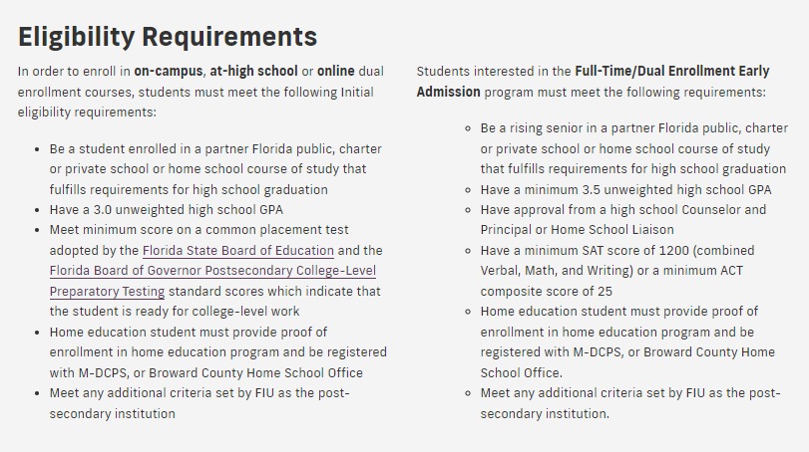
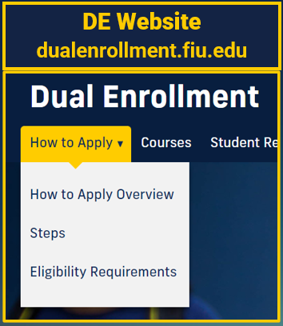
On-FIU Campus
Spring 2023 Early Admission 2023-24
Initial & Continued Eligibility Requirements

Slide 5
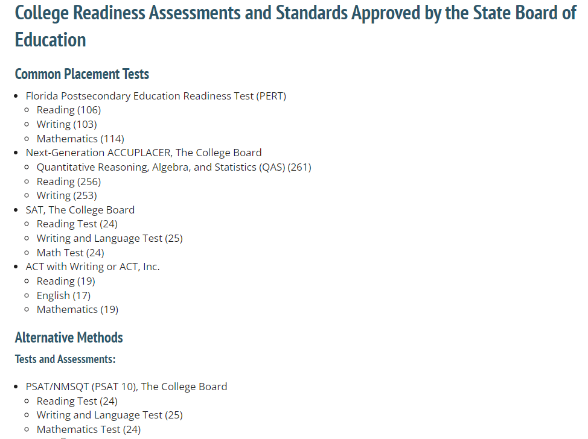
Accepted Tests & Scores

Slide 6
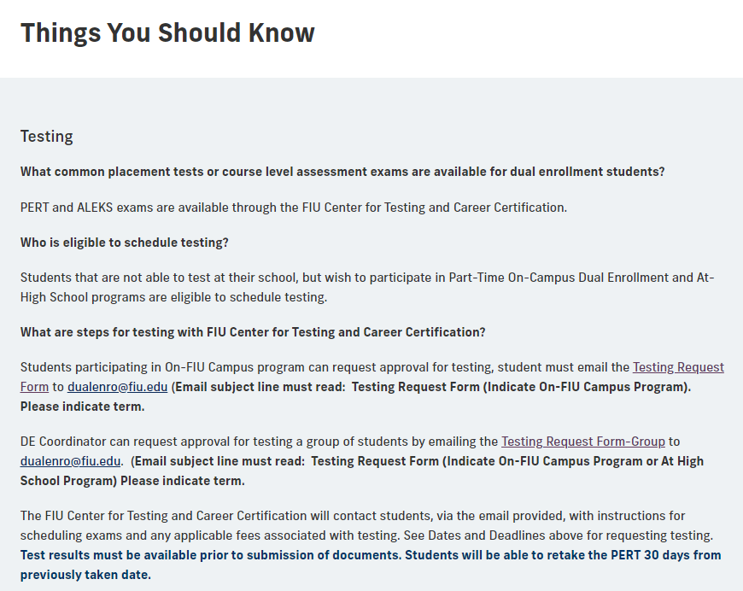
On-FIU Campus
Spring 2023 Early Admission 2023-24
PERT Testing Request
Visit DE Website STEPS page and view “Things You Should Know”

Slide 7
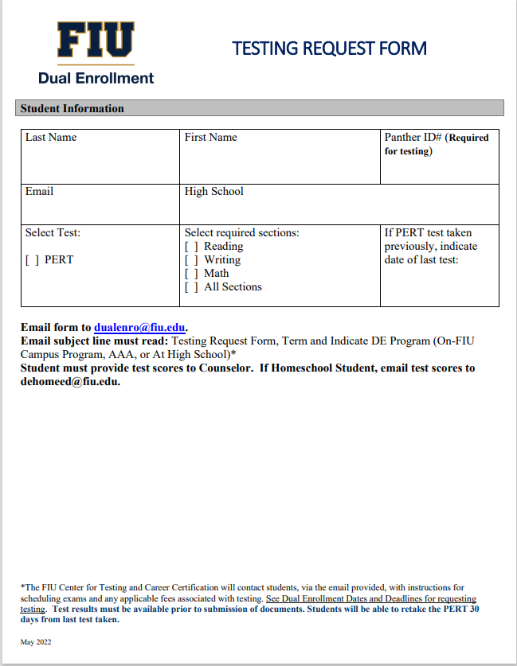
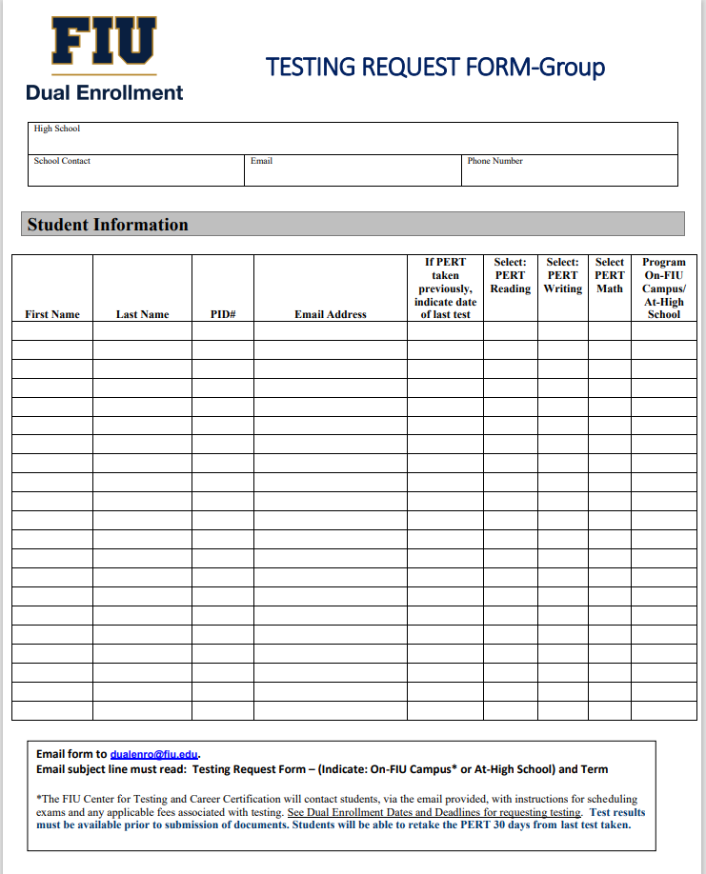
Testing Request Form Samples

Slide 8
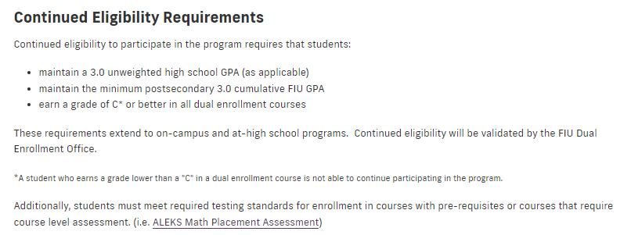
On-FIU Campus
Spring 2023
Early Admission 2023-24
Continued Eligibility & Pre-requisites

Slide 9
Make Wise Decisions
Choose University Core Curriculum (UCC) courses
Updated: 5/9/2022
Explore FIU degree pathways by taking electives that match student interest or degree aspirations.
https://dualenrollment.fiu.edu/Courses
my.fiu.edu

Slide 10
UCC Courses
UCC is a well-defined curriculum that includes General Education requirements together with Gordon Rule and Gordon Rule Writing Requirements
Communication
Humanities
Mathematics
Social Science
Natural Science
Arts

Slide 12
3 Easy Steps - Students
Step 1: Start Application
New Students – Apply Online
Returning Students - (only if not enrolled for 3 or more consecutive semesters)
Step 2: Complete Required Forms
Dual Enrollment Authorization Form
Immunization Form
Step 3: Submit Forms
DE Authorization Form – submit form to DE Coordinator/ School Counselor
Immunization Documentation Form –email form immune@fiu.edu

Slide 13
3 Easy Steps – DE Coordinator
Step 1: Verify Eligibility Criteria
Step 2: Review and Approve courses
Step 3: Upload DE Authorization Form to DE SharePoint
Students cannot register for classes until documents have been uploaded to SharePoint and registration window opens.

Slide 14
Dual Enrollment SharePoint
DE Authorization Forms must be uploaded to school folder on DE SharePoint
Upload forms individually for each student

Slide 15
First-time user: Request access by emailing dualenro@fiu.edu Previous user: Receive email notification to re-activate for Spring 2023 on November 4^{th,} 2023 Access is granted to a single school appointee

Slide 16
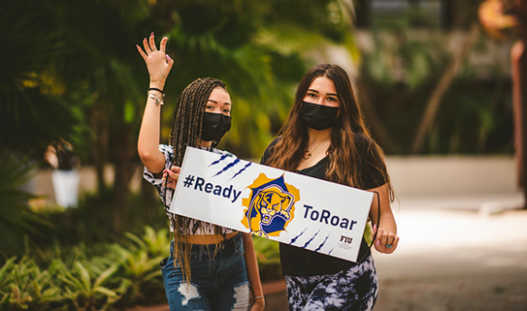
Full-Time DE Early Admission 2023-24
Step 1: Start Application
New Students - Apply Online
Returning Students - (only if not enrolled for 3 or more consecutive semesters)
Step 2: Request Interview
Email Required Documents to dualenro@fiu.edu
Official HS Academic Transcript
SAT or ACT Test scores
Recommendation Letter from School Counselor and/or Principal

Slide 17
Acceptance Letters April 24, 2023
Once admitted, student will receive instructions regarding:
Submission of DE Authorization Form
Managing Course Selection
Orientation
Registering for Course

Slide 18
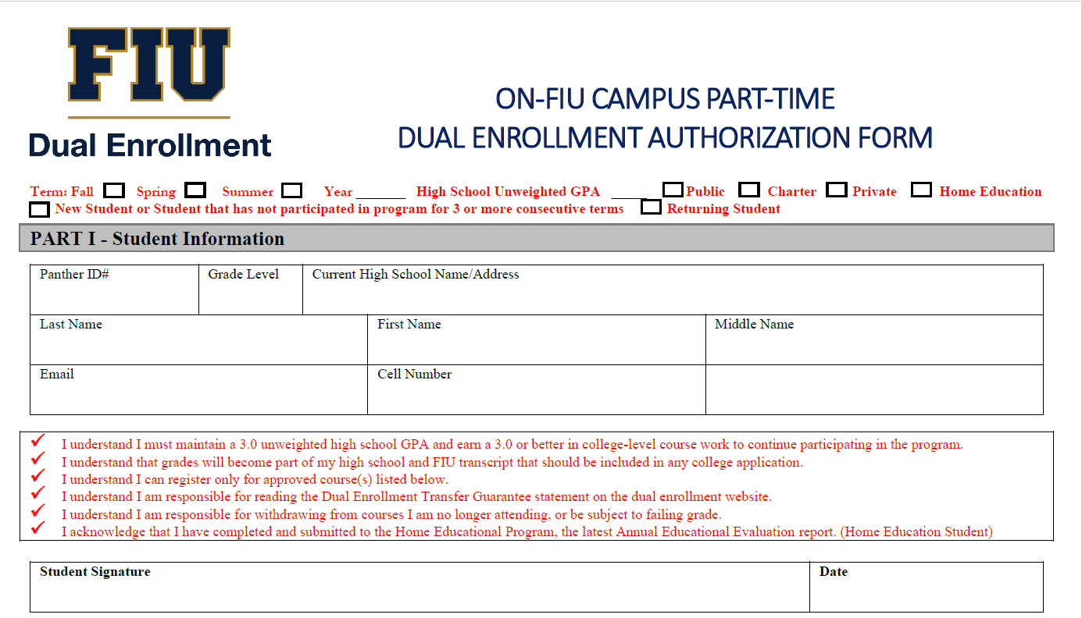

Slide 20
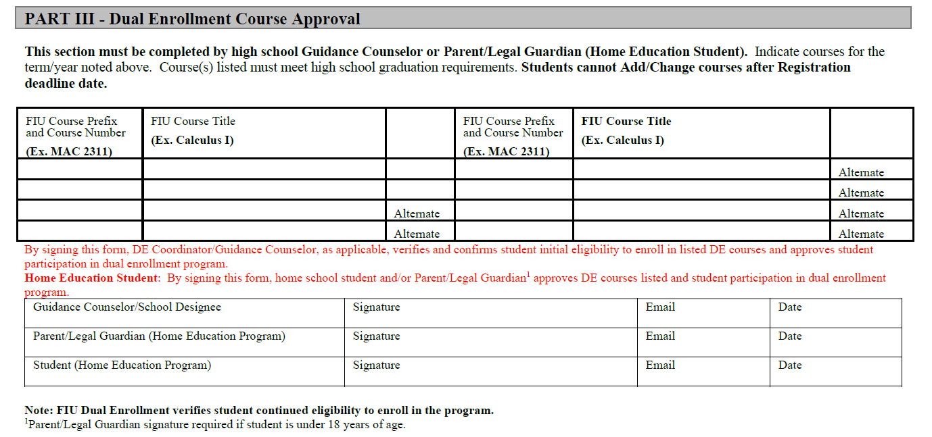

Slide 21
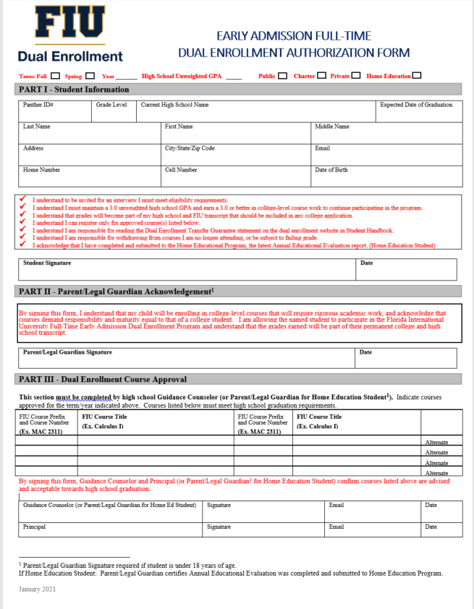
Early Admission
DE Authorization Form
Form will be emailed to student if admittted.
By signing this form, School Counselor and Principal (or Parent/Legal Guardian for Home Education Student) confirm courses listed above are advised and acceptable towards high school graduation.
[

Slide 22
Instructional Materials
Students place order through their FIU student portal after registration
Students are redirected to the Barnes & Noble course materials page to place order
Instructional Materials will be available for Pick up at the FIU Bookstore
Digital books (e-books) access codes will be emailed

Slide 23
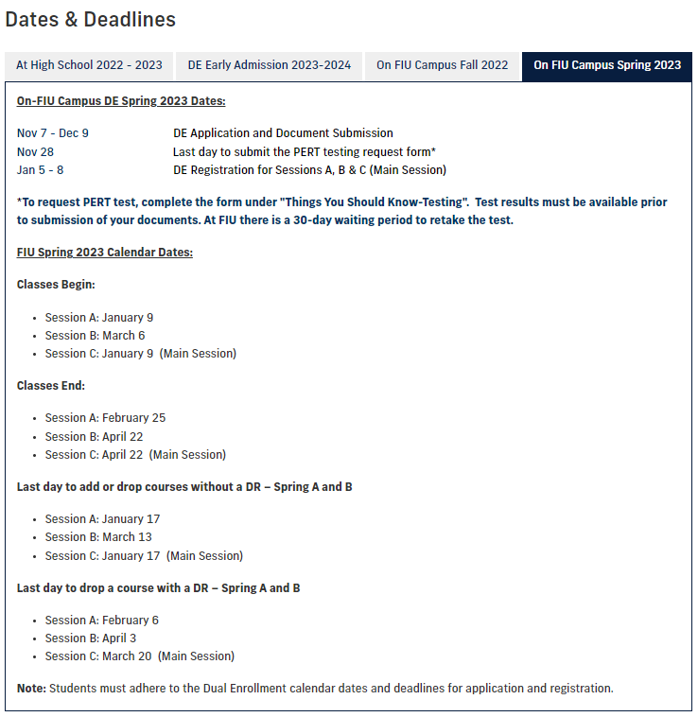
DE On-FIU Campus
Spring 2023

Slide 24
DE On-FIU Campus Early Admission 2023-24

Slide 25
FAQs
Q1. What are the common placement tests that are accepted by FIU for determining college readiness?
PERT/ACCUPLACER/SAT/ACT and PSAT
Q2. What common placement tests are offered at FIU? How can you test?
PERT, Testing request form is available on DE Website under “Things You Should Know”
Q3. What is the recommended course level and number of courses per semester for dual enrollment students?
Recommended course level is 1000 and 2000 level courses and 2 courses per semester
Q4. Can students select an Online course?
Yes, students may select courses offered In-Person, Online, or Hybrid

Slide 26
FAQs
Q5. What are “After Applying…What’s Next” emails?
A serious of communications sent to students from the DE Office providing them with status of their application and reminding them of important dates and deadlines.
Q6. What happens if a student registers for a course not listed and approved on the DE Authorization Form?
DE Office will email DE Coordinator/Guidance Counselor to request approval of course that the student selected.
Q7. How will the school know that students enrolled?
Enrollment notification will be sent to the schools after the semester Drop date.

Slide 27
FAQs
Q8. How are grades provided to the schools?
DE Coordinator/School Counselor will be able to access grades through the Dual Enrollment Extranet Sharepoint site.
Q9. How can students get their FIU transcript?
Students can request transcripts by visiting onestop.fiu.edu and searching “Transcripts”
Q10. How can DE Coordinator/School Counselor access “Credit By Exam” tables?
By visiting dualenrollment.fiu.edu Student Resources page under “Credit by Exam Tables”

Slide 28
DEstination FIU Navigate DE Website
https://dualenrollment.fiu.edu/

