Slide 1
FIU DUAL ENROLLMENT
Person of Interest (POI) Fall 2023 Workshop
August 9, 2023/August 15, 2023

Slide 2
Learning Plan
Familiarize you with:
Eligibility Requirements – Fall 2023
Application Process
HS DE Verification Process
In-Person Course
Online Course

Slide 3
OFF-CAMPUS PROGRAM (@ High School Program)
DE Courses Offered at the School Site
In-Person taught by credentialed school instructor or FIU Faculty
Online taught on Canvas by FIU Faculty with the support of the school appointed Facilitator

Slide 4
Eligibility Requirements
Initial Eligibility Criteria
Have a 3.0 unweighted HS GPA
Meet minimum score on a common placement test used to determine college readiness
Continued Eligibility Criteria
Maintain a 3.0 unweighted high school GPA
Maintain a 3.0 cumulative FIU GPA
Earn a grade of C or better in course
FIU verifies Continued eligibility criteria.
Tests accepted by FIU include:
Postsecondary Education Readiness Test (PERT)
Next-Generation ACCUPLACER
SAT
ACT
PSAT- Alternative Method
Holistic Approach Alternative Indicators
(Only for In-Person Course Sections)
HS GPA Academic Waiver
Determinants of College Readiness Factors
POI verifies Initial eligibility criteria

Slide 5
ACADEMIC WAIVER
Students with a 2.7 – 2.99 unweighted high school GPA are eligible to acquire academic waiver
Waiver not applicable for enrollment in:
Online courses
Courses offered at middle schools

Slide 6
Determinants of College Readiness Factors
The FIU DE program holistic approach consists of using GPAs, past performance in related courses, and college readiness scores to evaluate students.
The table presents factors which can be considered in the holistic approach for determining enrollment.

Slide 7
Application
Application Window Opens: August 17 – September 1
New/Returning Students
New Students create online application on DE website-this generates PID#
Returning Students log in to my.fiu.edu go to the Manage Classes
Plan of Action
When will students create application?
Who will facilitate the process, instructor or POI?
Who will collect the Parent Consent Form?
Who will complete the Waiver?
School and courses appear on the application portal
Parent Consent Form is generated at the end of the application and must be collected and filed
Academic Waiver must be completed and filed, if applicable
What’s Next ?
Access the HSDE Registration List
Verify Eligibility Criteria
Validate Class Rosters

Slide 8
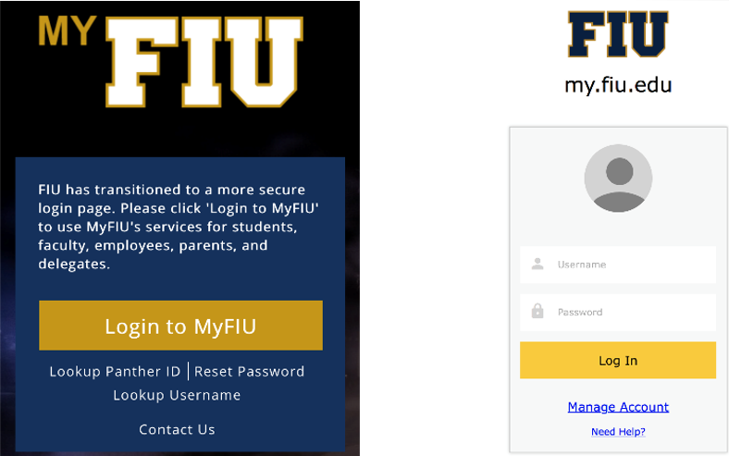
HSDE Registration List FIU PantherSoft
Task: Approve or Deny the Students
Validate Class Roster
Required indicators completed by POI:
Assigned Period
Unweighted HS GPA
Grade Level
Common Placement Test and Scores - NEW
All other indicators are facilitated through drop down options.
Password must meet revised policy requirements
Note: Use Add/Drop form for Online courses

Slide 9
Fall 2023 Dates & Deadlines
OFF-CAMPUS
Application Opens: August 17 – September 1
Last day to Drop course: October 19
SPOTs Student Perception of Teaching:
November 27 – December 15
Beginning October 1st:
Annual Cybersecurity Training Module opens
DE Compliance Site Visits will be scheduled

Slide 10
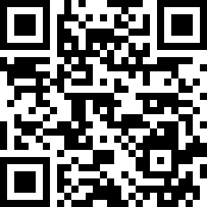
FIU Dual Enrollment Website
Visit: https://dualenrollment.fiu.edu/
Email: dualenro@fiu.edu

Slide 11
Thank You!
Real Impact

